Slide 1

ENPM809J Troll World Enterprise Cloud Migration
Dheepshika Raghunathan

Slide 2

Agenda
Troll World Overview
Current Architecture
Risks in Current Architecture
Merits of Migrating to Cloud
Proposed Architecture
Infrastructure and Services
Trolls Internal Operational Zone
Identity and Access Management
Conclusion

Slide 3

Troll World Overview
The Trolls are small creatures who live in an almost perpetual state of happiness, singing, dancing and hugging all day long
After many years of conflict, Bergens and Trolls are now friends
Bergens now have Trollmania and are interested in everything Troll-related
Bergens are now the largest customers of Troll videos in the ENPM809J Troll World website

Slide 4
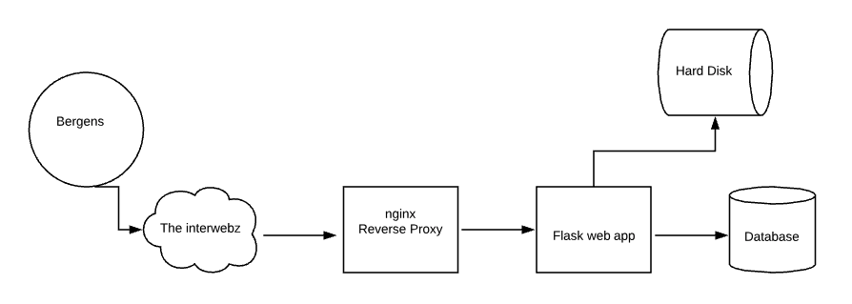
Current Architecture
Currently, ENPM809J Troll World runs in a single Linux system
The code is written in Python3 and Flask
Nignx reverse proxy is being used
Videos are stored in the hard disk
MySQL Database stores the queries

Slide 5

Risks in Current Architecture
No patching or backup strategy
No access management
Vulnerable to DDoS attacks and compromise attempts by The Chef
Susceptible to hardware failures and troll errors
Slow downloads and order processing

Slide 6

Merits of Cloud Migration
Maintenance cost will be reduced
High availability of ENPM809J Troll World website
Scalability and Elasticity of Cloud resources
Easy Load Balancing
Protection from DDoS and common web exploits
Secure application
Controlled user access to application components
Automated deployment and patching
Enhanced application monitoring and backup mechanism
Pay as you go!

Slide 7
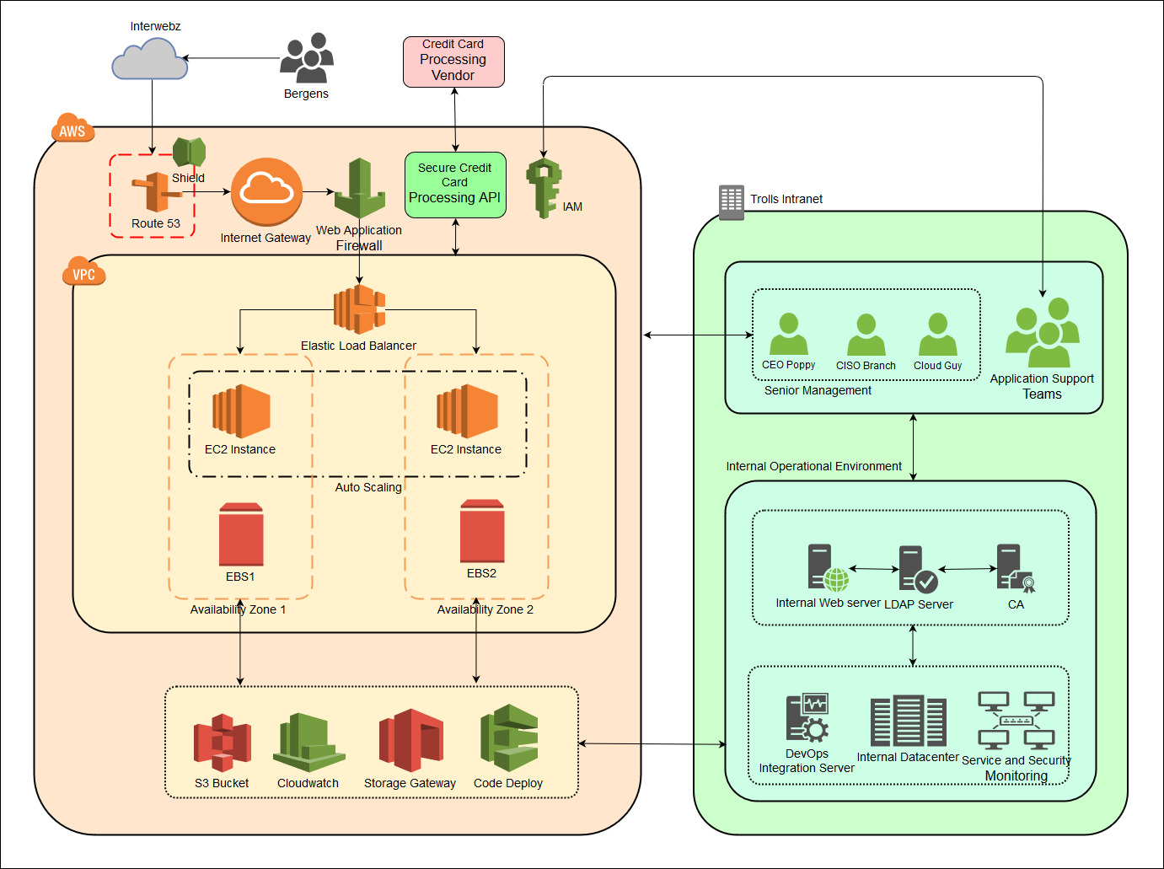
Proposed AWS Cloud Architecture

Slide 8
Infrastructure and Services
AWS Infrastructure Components
Network Zone
Server Zone
AWS IT Utility Services
Credit Card Payment Process
Identity and Access Management Service
Trolls Private Infrastructure Components
Trolls Internal Operational Zone
Server Zone
DevOps Integration
LDAP server

Slide 9
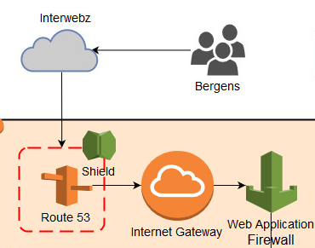
Network Zone
ENPM809J Troll World will be hosted in AWS cloud environment
Bergens will access it through the Interwebz
Route 53 will provide the DNS service to access ENPM809J Troll World
AWS Shield service will be used at the Route 53 DNS to prevent DDoS attacks
Route 53 DNS will redirect the requests to the Internet Gateway
Requests will then be redirected to the application servers through the Web Application Firewall (WAF)
AWS Web Application Firewall will protect the application from common web exploits

Slide 10
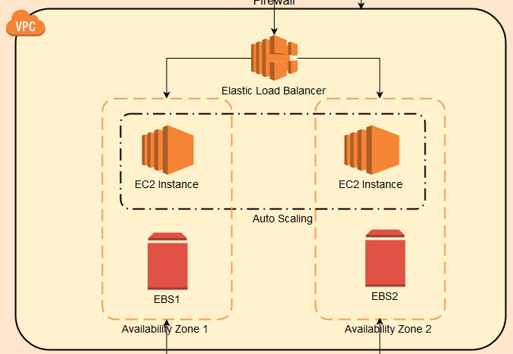
AWS Server Zone
ENPM809J Troll World will be hosted in 2 geographically distinct availability zones
EC2 instances will host the application
Auto Scaling will be implemented on the EC2 instances to improve performance
Requests will be distributed to the EC2 instances through the Elastic Load Balancer, based on application load and instance availability
Both availability zones will host Elastic Block Storage Instances to hold a copy of the Bergens customer details

Slide 11
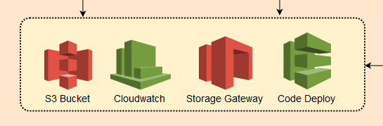
AWS IT Utility Services
S3 Bucket will store all the Trolls On-Demand Videos
AWS Cloudwatch will be used to monitor all AWS services and to push logs to the Trolls Internal Application server
AWS Storage Gateway will be used to backup the ENPM809J Troll World website to the Trolls Internal Application server, for archiving, disaster recovery and migration purposes
AWS Code Deploy will be used to push application patches and configuration changes from development environment to production.

Slide 12
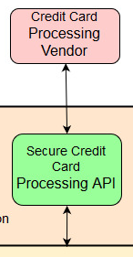
Credit Card Payment Process
Various Secure Credit Card Payment APIs could be used to process customer payments
The APIs will connect to the Credit card vendors to process payments
Amazon provides various secure 3rd party payment APIs
DevPay – Online billing and account management service provided by Amazon
Stripe – Secure 3rd party payment gateway supported by AWS

Slide 13
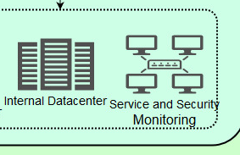
Trolls Internal Operational Zone
Internal Data Center will be used to store the ENPM809J Troll World application backup.
Service and Security Monitoring will accept and store the logs from AWS Cloudwatch and provide effective way to monitor the Troll World internal application

Slide 14
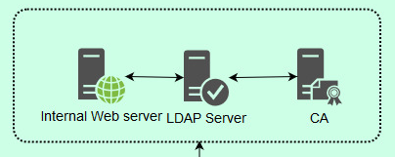
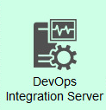
Internal Server Zone
Internal Web Server will be used to host the Troll World internal application and services
LDAP server will be used to hold the employee directories
LDAP server will connect with the CA server to validate the employee authentication certificates
DevOps Intergration Server will be used to implement Continuous Integration and Continuous Deployment (CI/CD)
To implement automatic patch updates to production
To automate development and testing activities

Slide 15
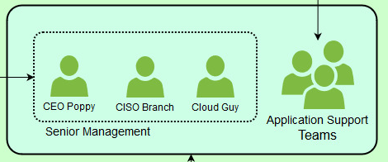
Troll World User Classification
Troll World employees could be classified as
Senior Management
Application Support Teams
Multifactor Authentication will be implemented for all users
Senior Management includes
Includes
Poppy, CEO
Branch, CISO
Cloud Guy
Have Admin access to AWS environment

Slide 16

Identity and Access Management
Troll World application support teams access the required AWS services through Identity and Access Management (IAM)
Individuals from various teams could be assigned to various IAM Groups
User/Access | System Administration | Web Component | Network Component
Smidge | ✓
Guy Diamond |  | ✓
Biggie |  |  | ✓
Cooper | ✓ | ✓

Slide 17

Conclusion
ENPM809J Troll World will now be ready to face any challenges from the Burgens!
Trolls will now have a robust IT environment and their On-Demand videos business will grow!

